Slide 1
4th Dimension Putt Putt Golf App
By Trax Bagley, Thadeus Ferney, Caleb Harris, Nick Sorenson

Slide 2
Project Overview
Description: Create a Web app to manage and track Golf tournaments for a putt putt golf tournament bar and grill. The application will serve five actors: managers, owners, players, drink meisters, and sponsors. These actors will be served via the application or app, which houses features to manage and order drinks, setup the Golf tournament, and keep track of players scores in the tournament.
Tool Stack: Django, React, and Redux.

Slide 3
Project Overview
Design choices: During the creation of this application, there were many key design choices to be made. One requirement we had agreed on was a mobile friendly web application. We believe we have accomplished this.
We especially focused on the functionality of our code. With the help of our modern tool stack, our code is efficient and reactive. This makes our user interface easy to use and reliable. For the look of our website, we decided to go for a clean and fresh aesthetic.

Slide 4
Requirements - Gameplay
2 . Player 2.1 Must:
d . Participate in Golf Tournament · Add Strokes to Score · Win Tournament · Optional Resignation
3 Manager 3.1 Must:
e. Tournament Setup · Decide the Start and End Time of a Tournament · End a Tournament Prematurely
4 Sponsor 4.1 Must:
a. Tournament Setup · Sponsor Prize Money for a Prize Pool · Pick a Date to Sponsor

Slide 5
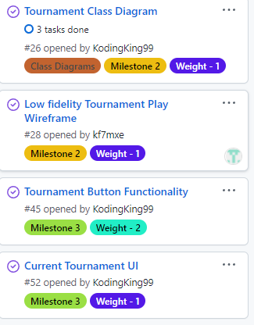
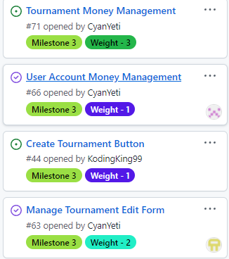
Gameplay Stories

Slide 6
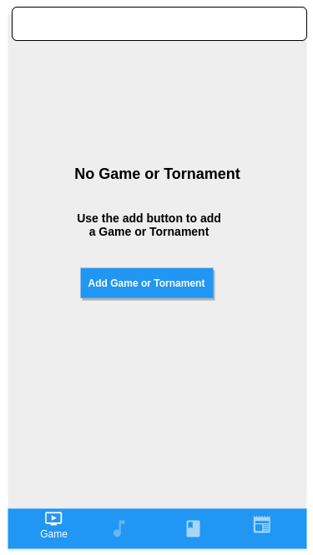
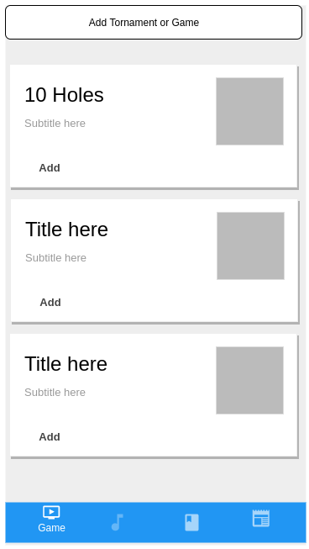
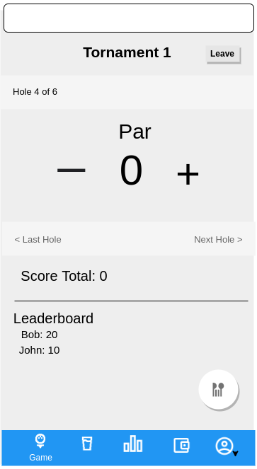
Gameplay Prototypes

Slide 7
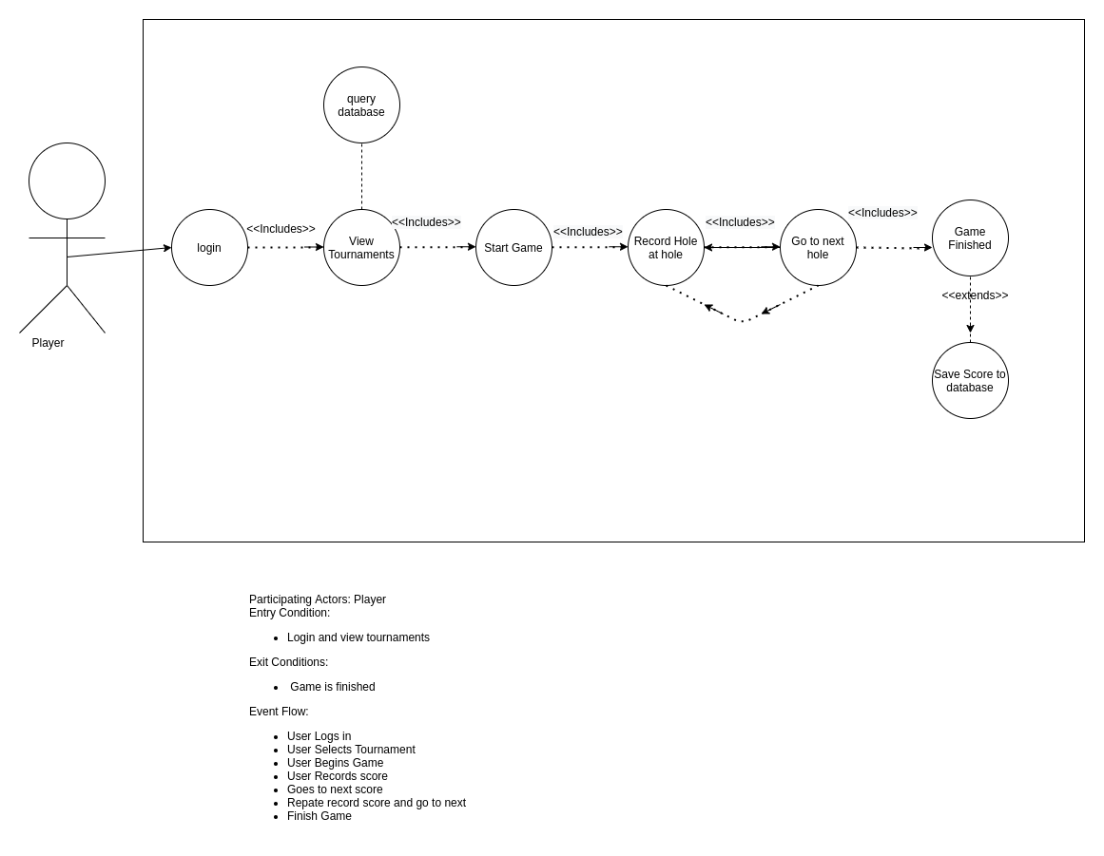
Gameplay Use Case

Slide 8
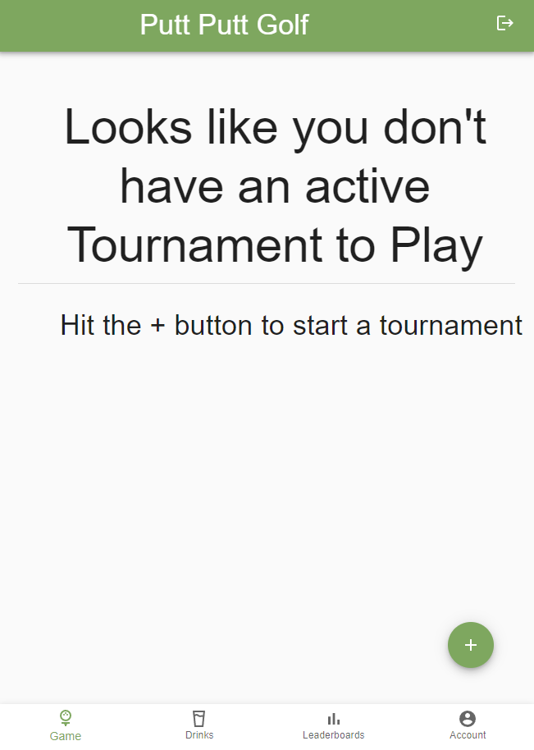
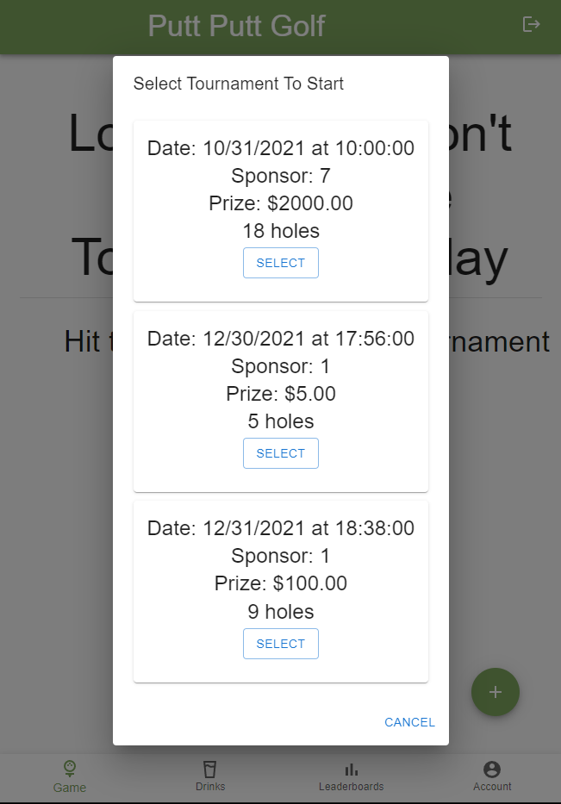
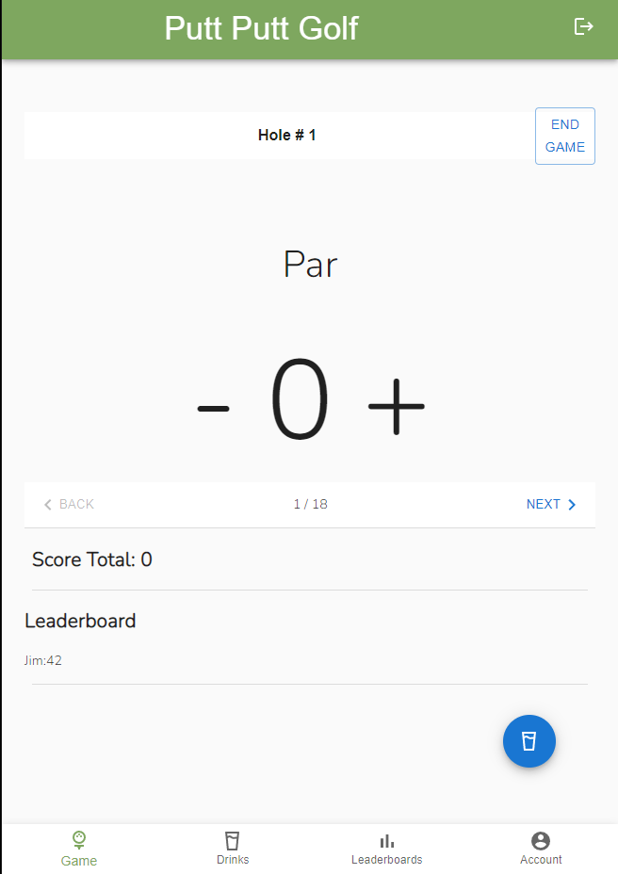

Slide 9

Gameplay Screen Capture

Slide 10
Requirements - Manager/Owner Capabilities
Owner 1.1 Must: a . Assigns user Roles b . Manage Personal and Store account
3. Manager
3.1 Must:
a . Assign sponsors to a given tournament b . Manage user permissions c . Customize the drink menu d . Provide refunds e . Tournament Setup · Decide the start and end time of a tournament · end tournaments prematurely 3.2 Should: a . Be able to refund orders and see order history.

Slide 11
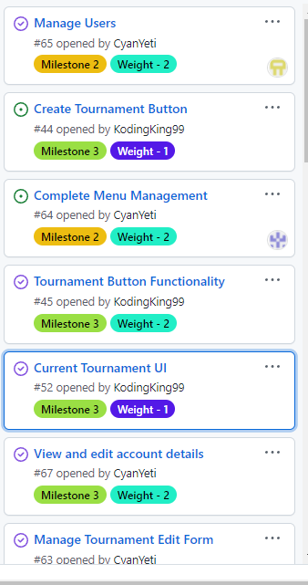
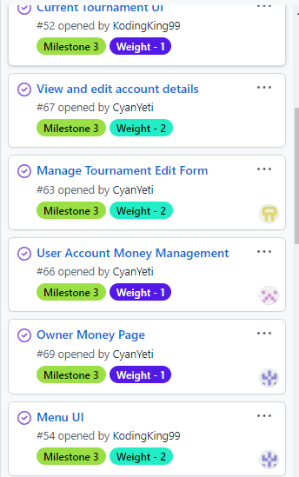
Manager/Owner
Stories

Slide 12
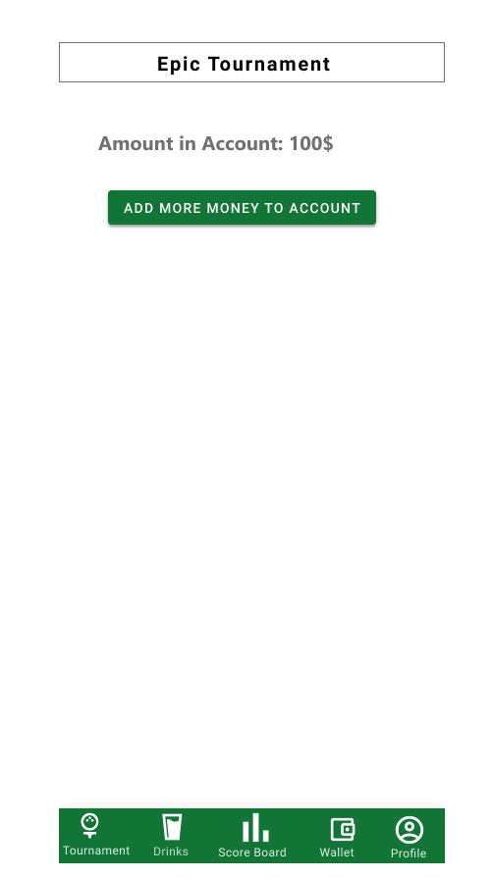
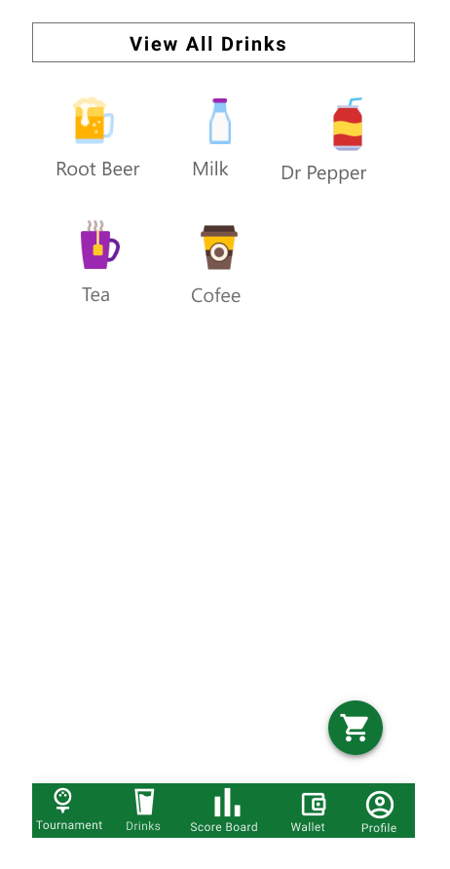
Manager/Owner
Prototypes

Slide 13
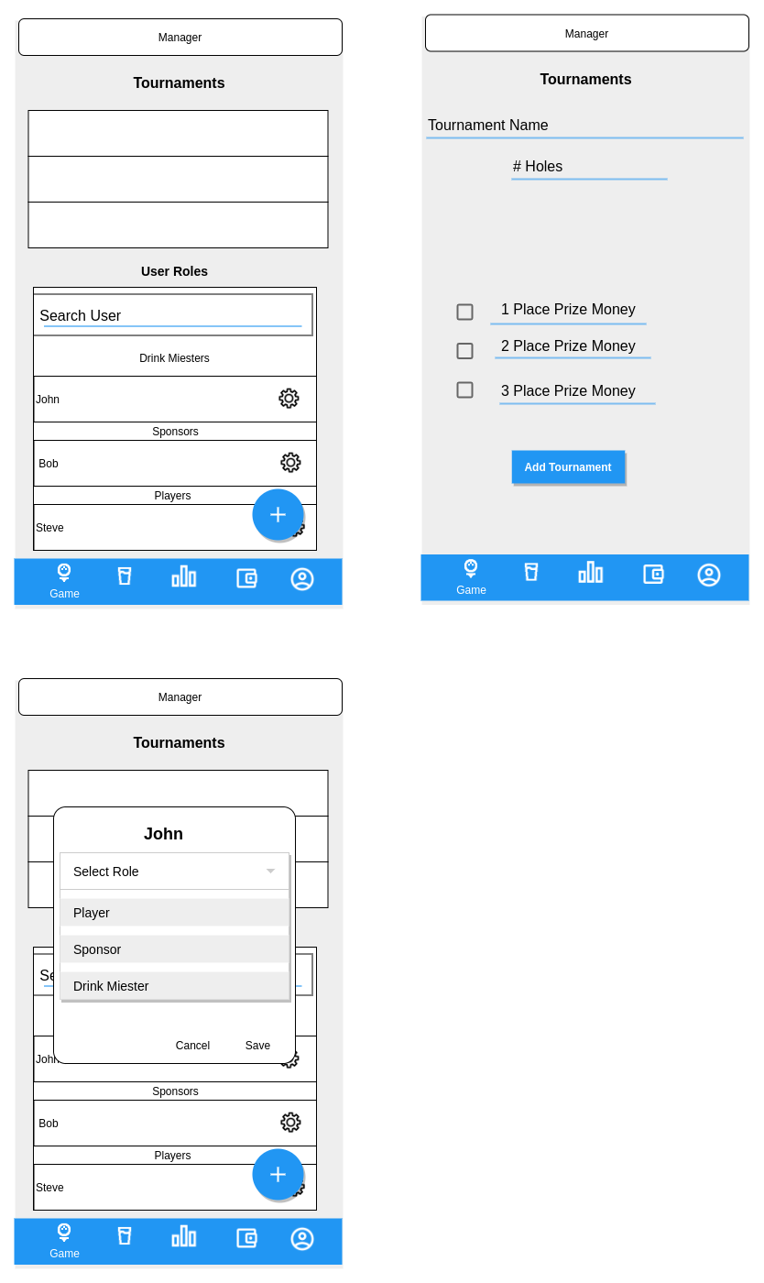
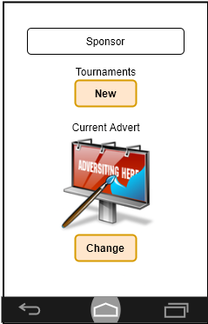
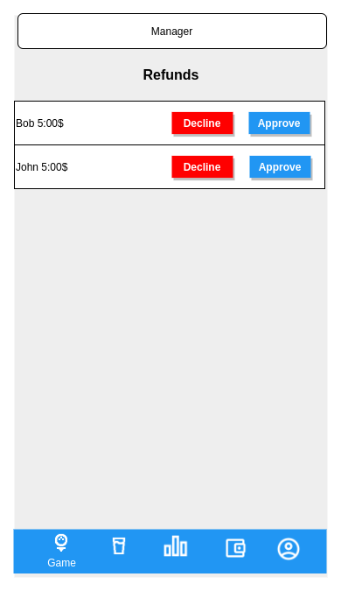
Manager/Owner Prototypes

Slide 14
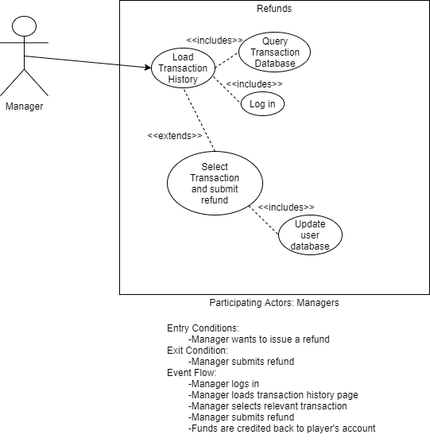
Manager
Refund Use Case

Slide 15
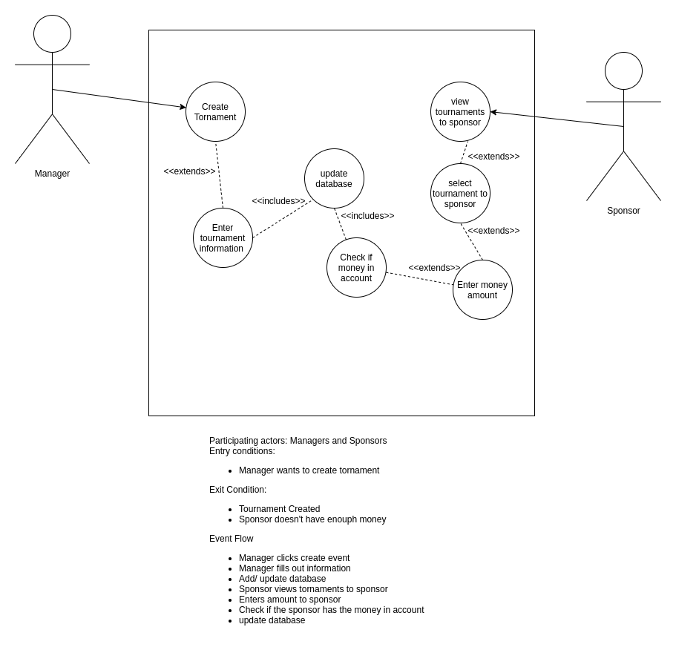
Manager
Create Tournament
Use Case

Slide 16
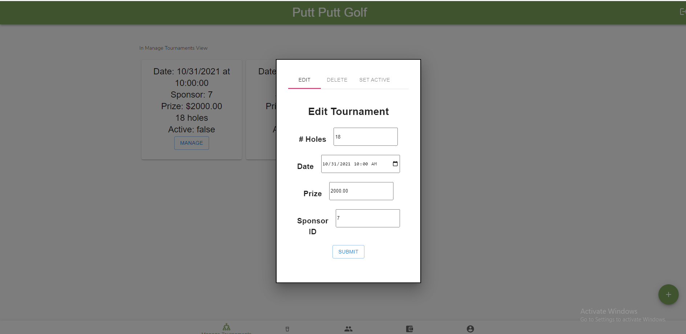
Manager
Create Tournament
Use Case

Slide 17
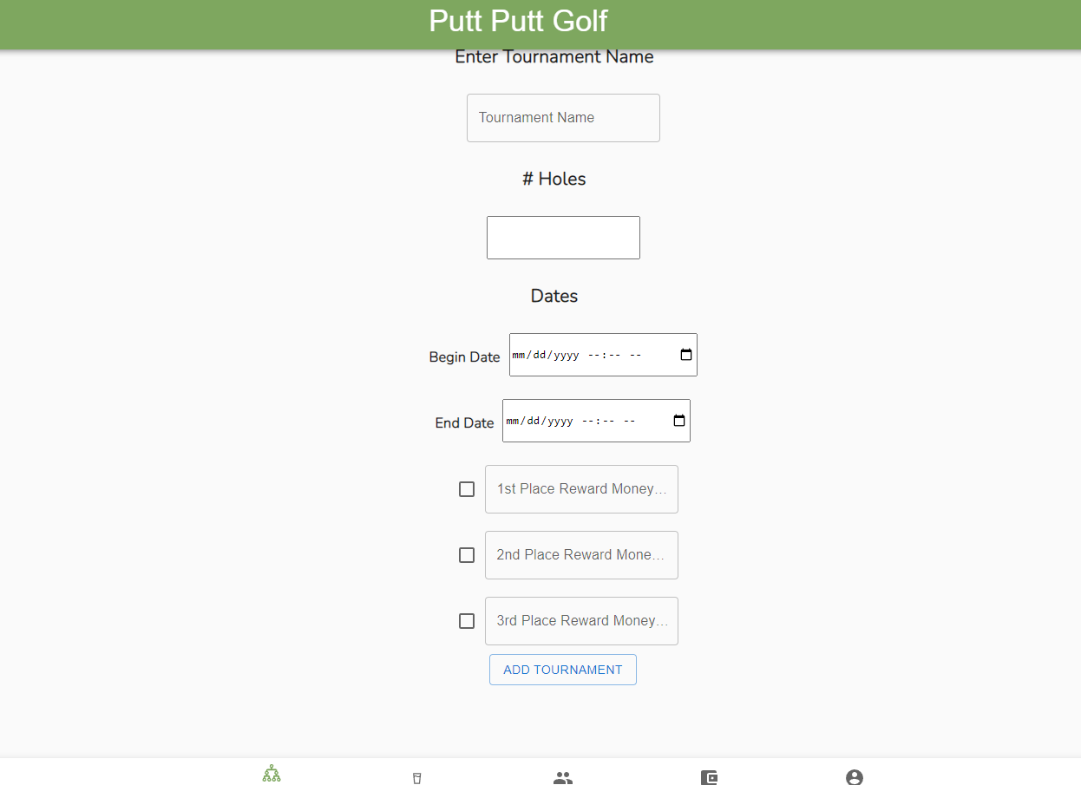

Slide 18
Manager
Screen
Capture

Slide 19
Ower
Screen
Capture

Slide 20
Requirements - Drink Ordering
2 . Player 2.1 Must: a . Create Account b . Order drinks · View Drink Menu · Add items to Cart · Checkout · Order from favorites bar
5 . Drink Meister 5.1 Must: a . Serve Players · Make Orders · Deliver Orders to Player · View Current Orders · Complete Player Orders and Confirm delivery

Slide 21
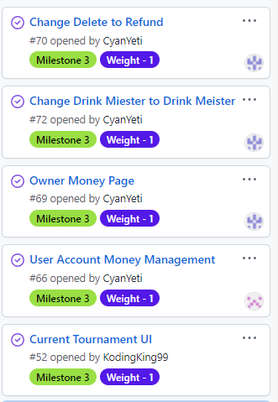
Stories

Slide 22
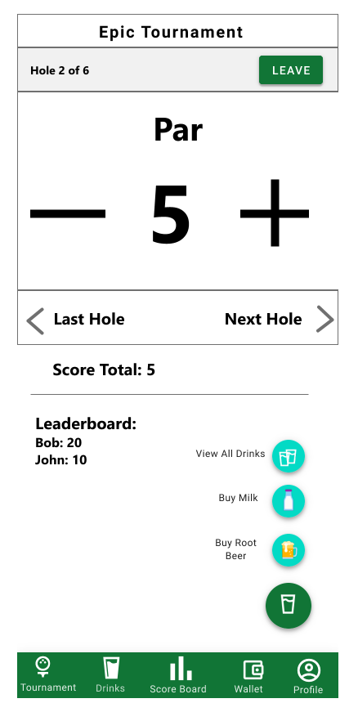
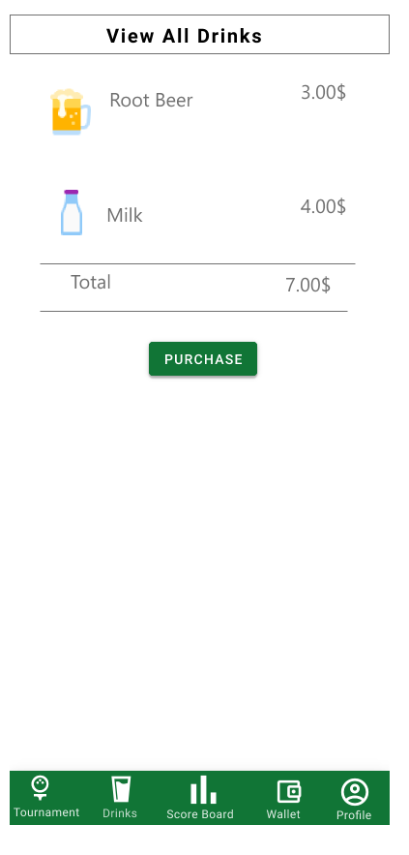
Prototype

Slide 23
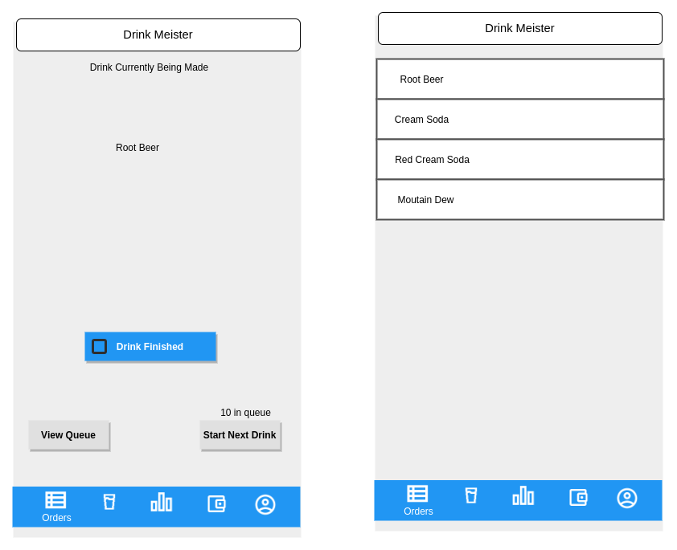
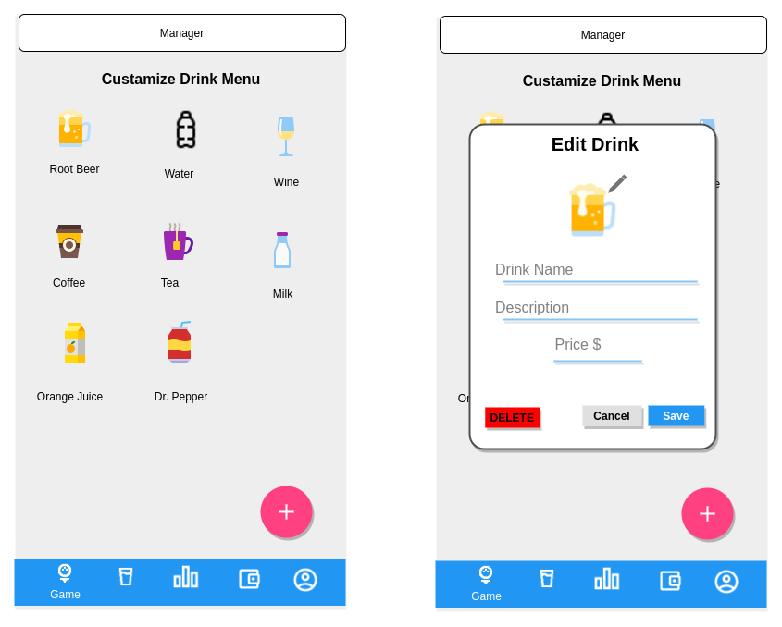
Prototype

Slide 24
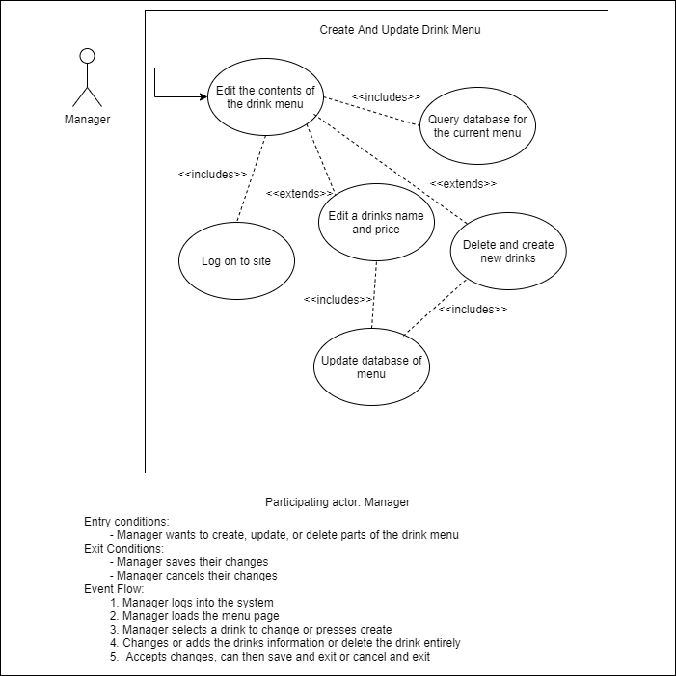
Drink Menu
Use case

Slide 25
Drink Menu
Use case
Refunds
Use Case

Slide 26
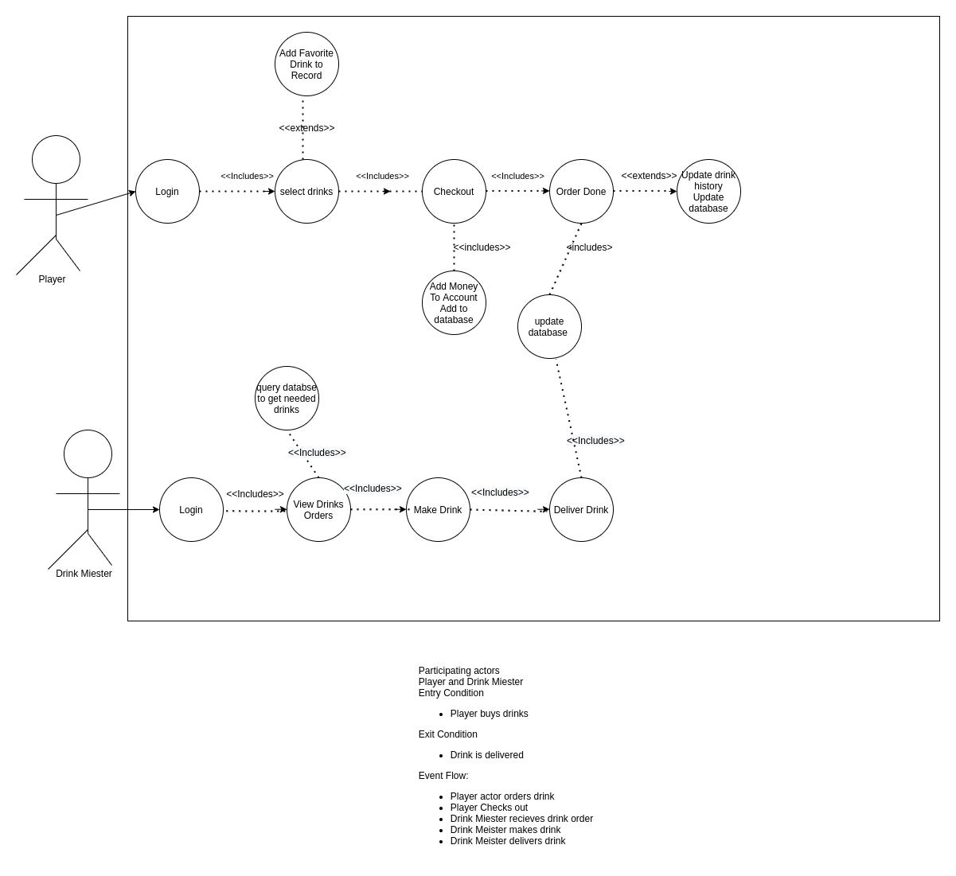
Order Drinks
Use Case

Slide 27
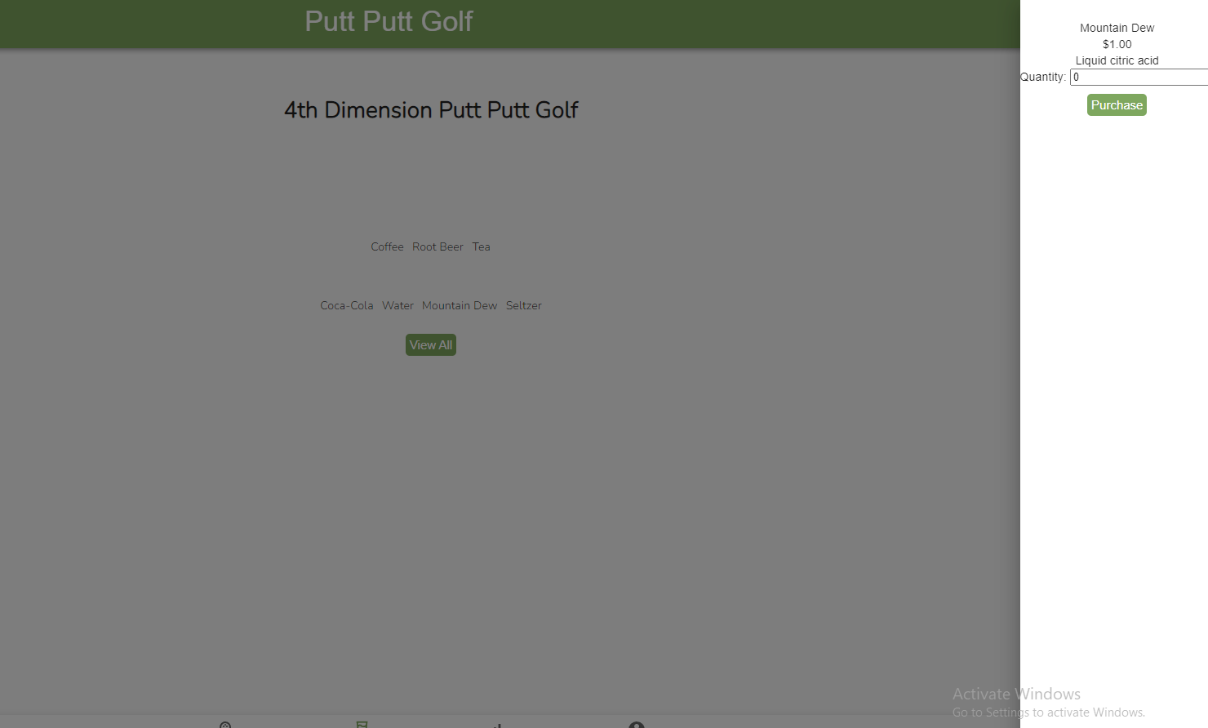
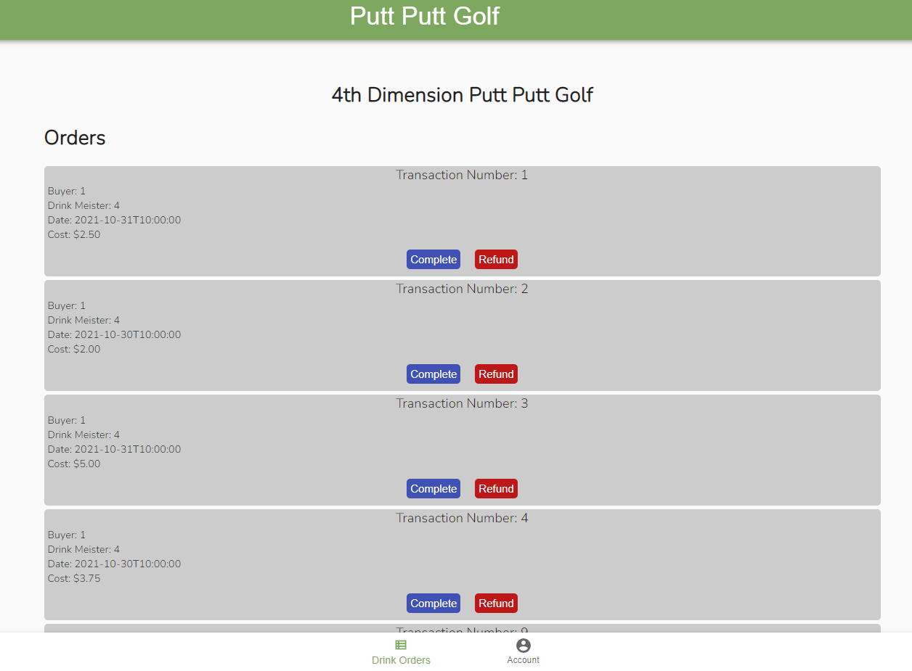

Slide 28
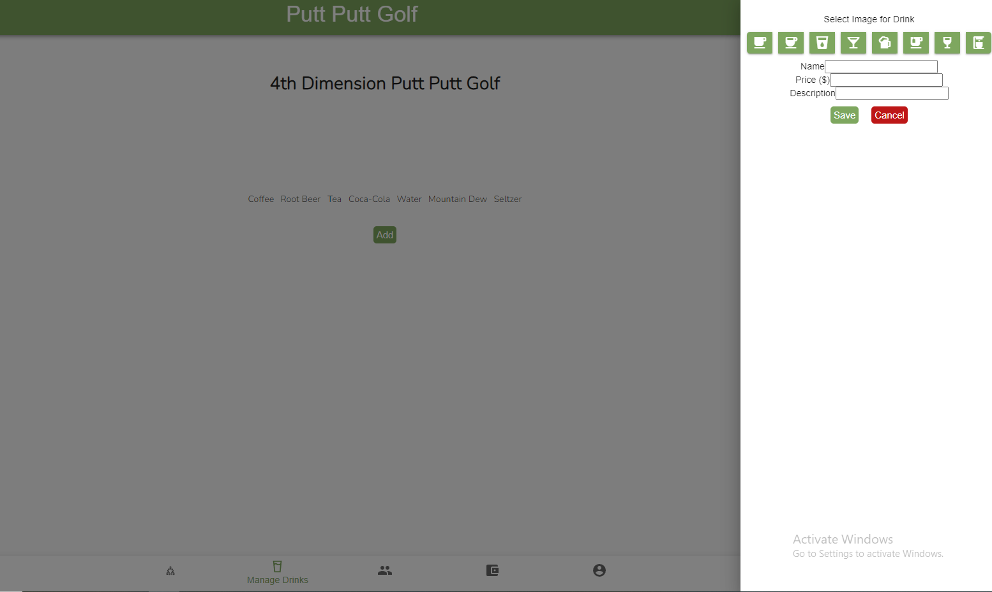

Slide 29
Drink Order
Screen
Capture

Slide 30
Capture
-
Account
Creation

Slide 31
Capture -
Manager
Create
Tournament

Slide 32
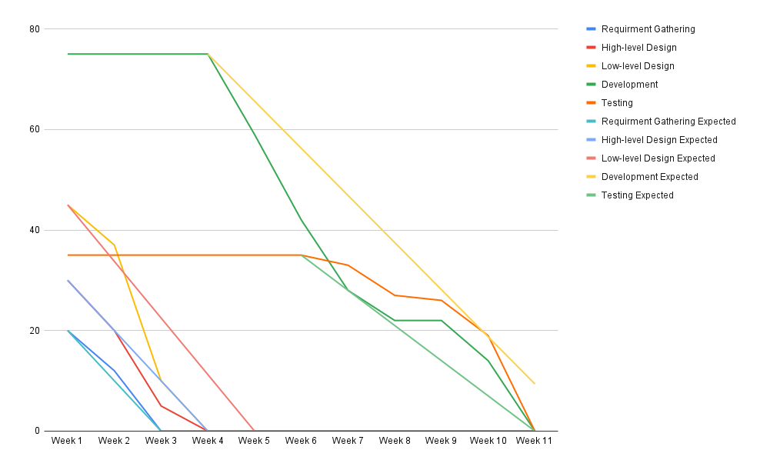
Burndown
Chart

Slide 33
Resources
Django Project Foundation. (2005–2021). Writing your first Django app, part 1 | Django documentation | Django. DjangoProject.Com. Retrieved October 8, 2021, from https://docs.djangoproject.com/en/1.8/intro/tutorial01/
Gagliardi, V. (2021, March 12). Tutorial: Django REST with React (and a sprinkle of testing). Valentinog.Com. Retrieved October 6, 2021, from https://www.valentinog.com/blog/drf/
Lillie, D. (2018, June 9). Django & React: JWT Authentication - Dakota Lillie. Medium. Retrieved October 7, 2021, from https://medium.com/@dakota.lillie/django-react-jwt-authentication-5015ee00ef9a
Redux Toolkit. (2021). Usage Guide | Redux Toolkit. Https://Redux-Toolkit.Js.Org/. https://redux-toolkit.js.org/usage/usage-guide
Traversy Media. (2019, January 29). Full Stack React & Django [2] - Implementing React. YouTube. Retrieved October 14, 2021, from https://www.youtube.com/watch?v=GieYIzvdt2U&t=1196s&ab_channel=TraversyMedia

Slide 34
Questions?

